Slide 1


Project Description
This project is about generating insights from the raw database of Instagram users, using SQL functions and queries solving the asked questions and gaining knowledge on SQL. This project aims to understand the database and explore it. User analytics means to track users engagement then launch new features and take beneficial business decisions for that app.

Slide 2
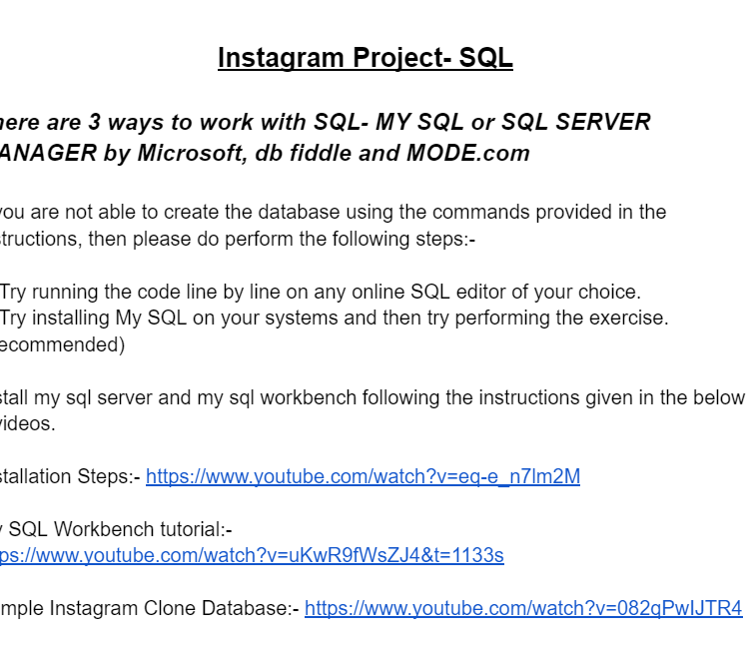

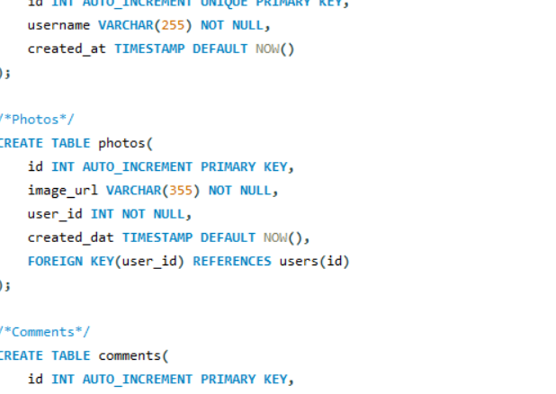
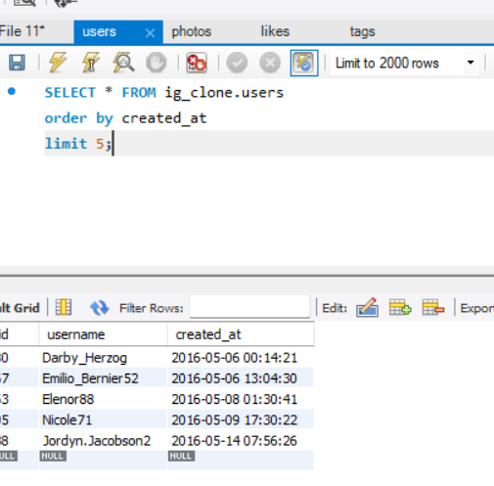
Approach
1. Read SQL installation resources given in the dataset
2. Installed Mysql workbench
3. Created the database ig_clone
4. Used SQL knowledge to run queries to get desired output

Slide 3
Tech Stack Used
Downloaded MySQL Workbench
Version 8.0.32
Purpose : It is a free, open source Relational Database Management System(RDBMS) that uses Structured Query Language(SQL)

Slide 4

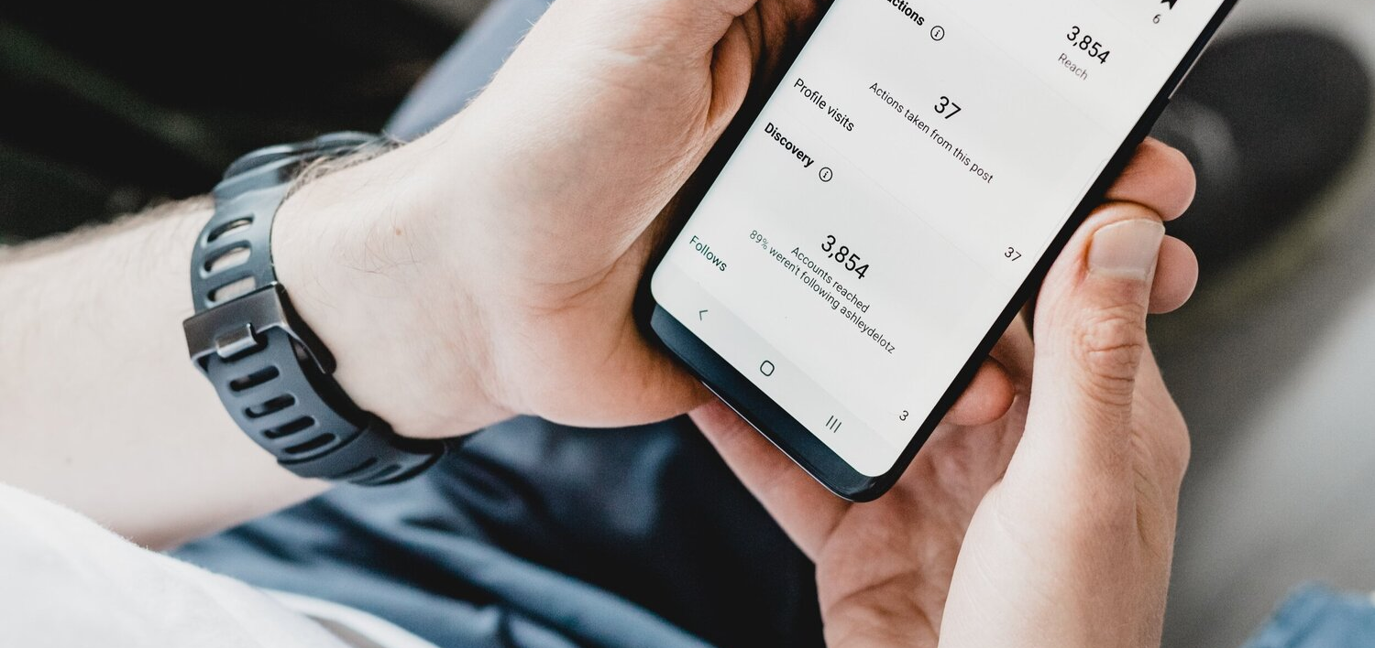
Insights
MARKETING

Slide 5
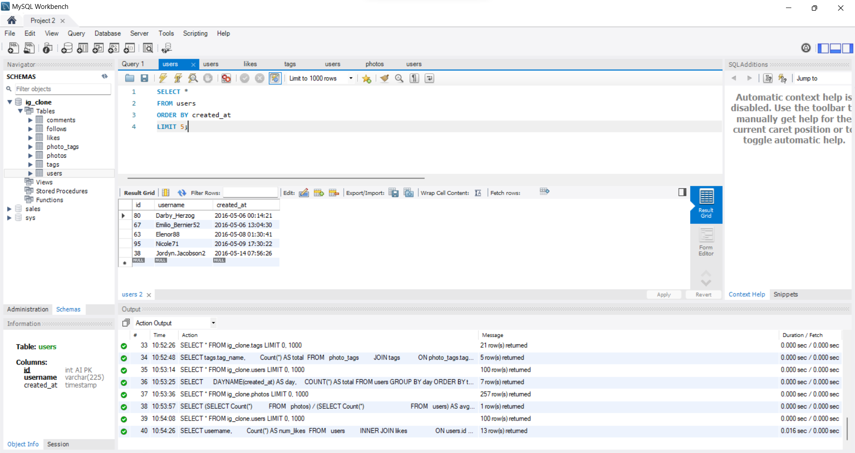
Rewarding Most Loyal Users

Slide 6
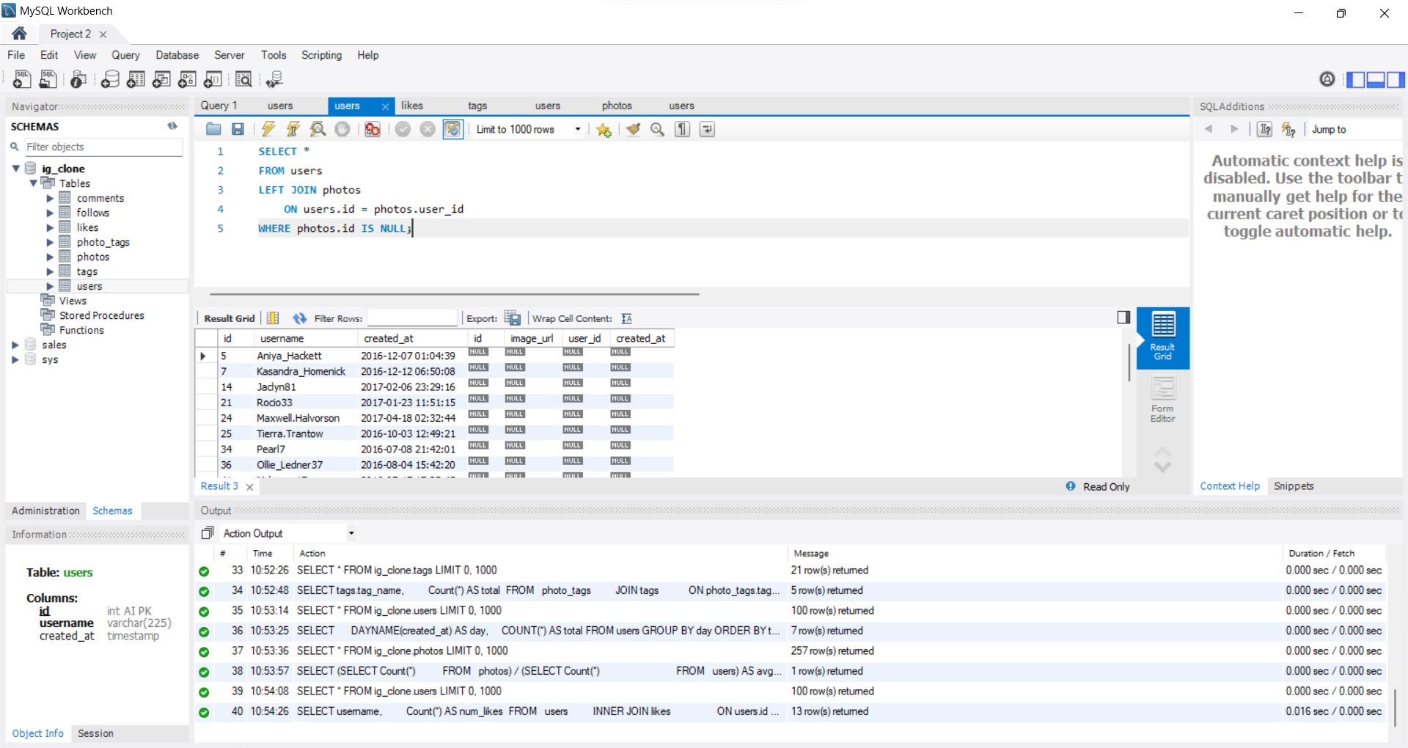
Remind inactive users to start posting

Slide 7
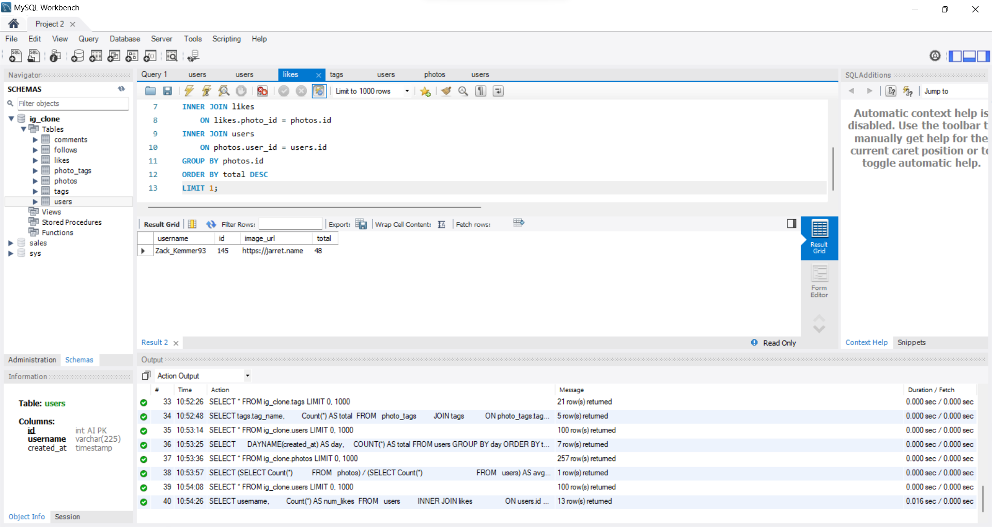
Declaring Contest Winner

Slide 8
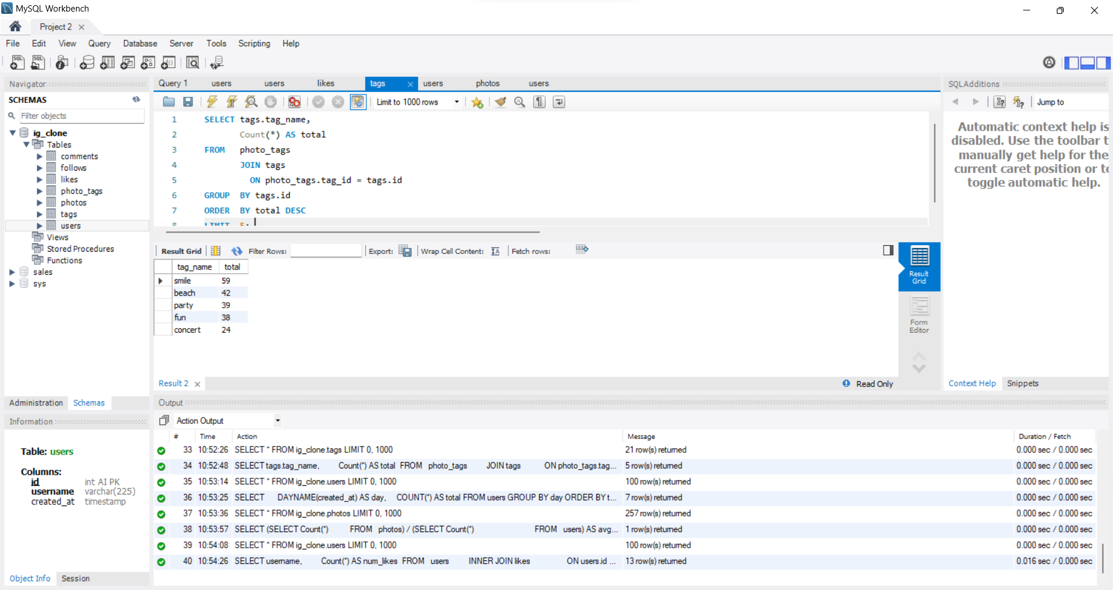
Hashtag Researching

Slide 9
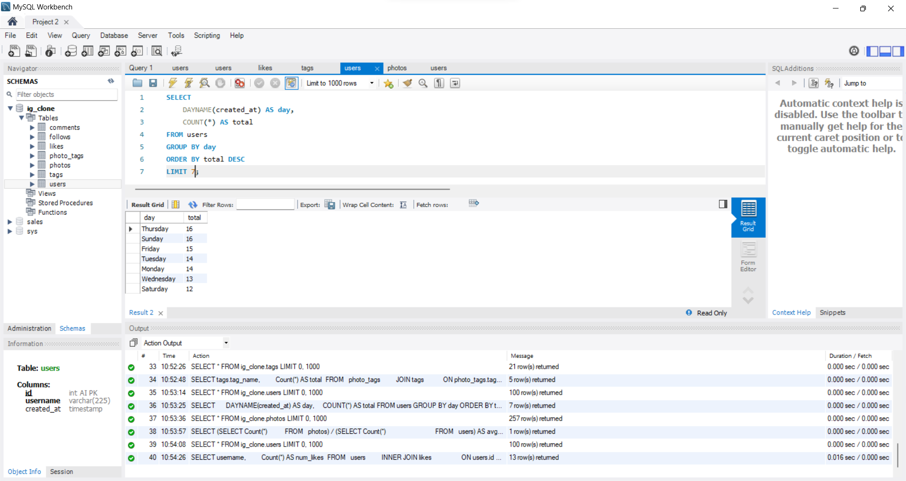
Launch Ad Campaign

Slide 10
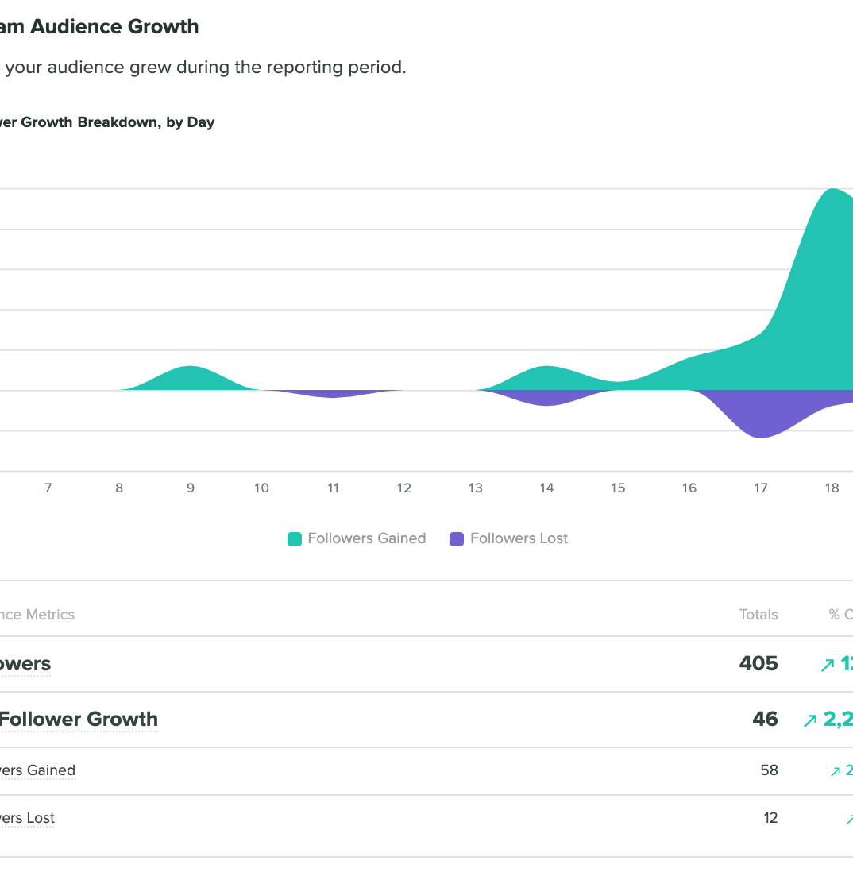

Insights
Investor metrics

Slide 11
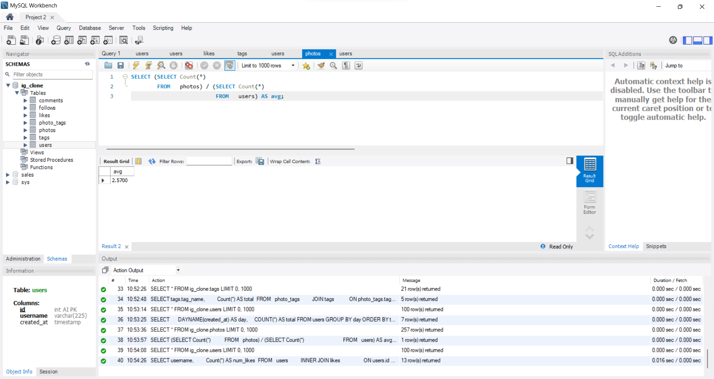
User Engagement

Slide 12
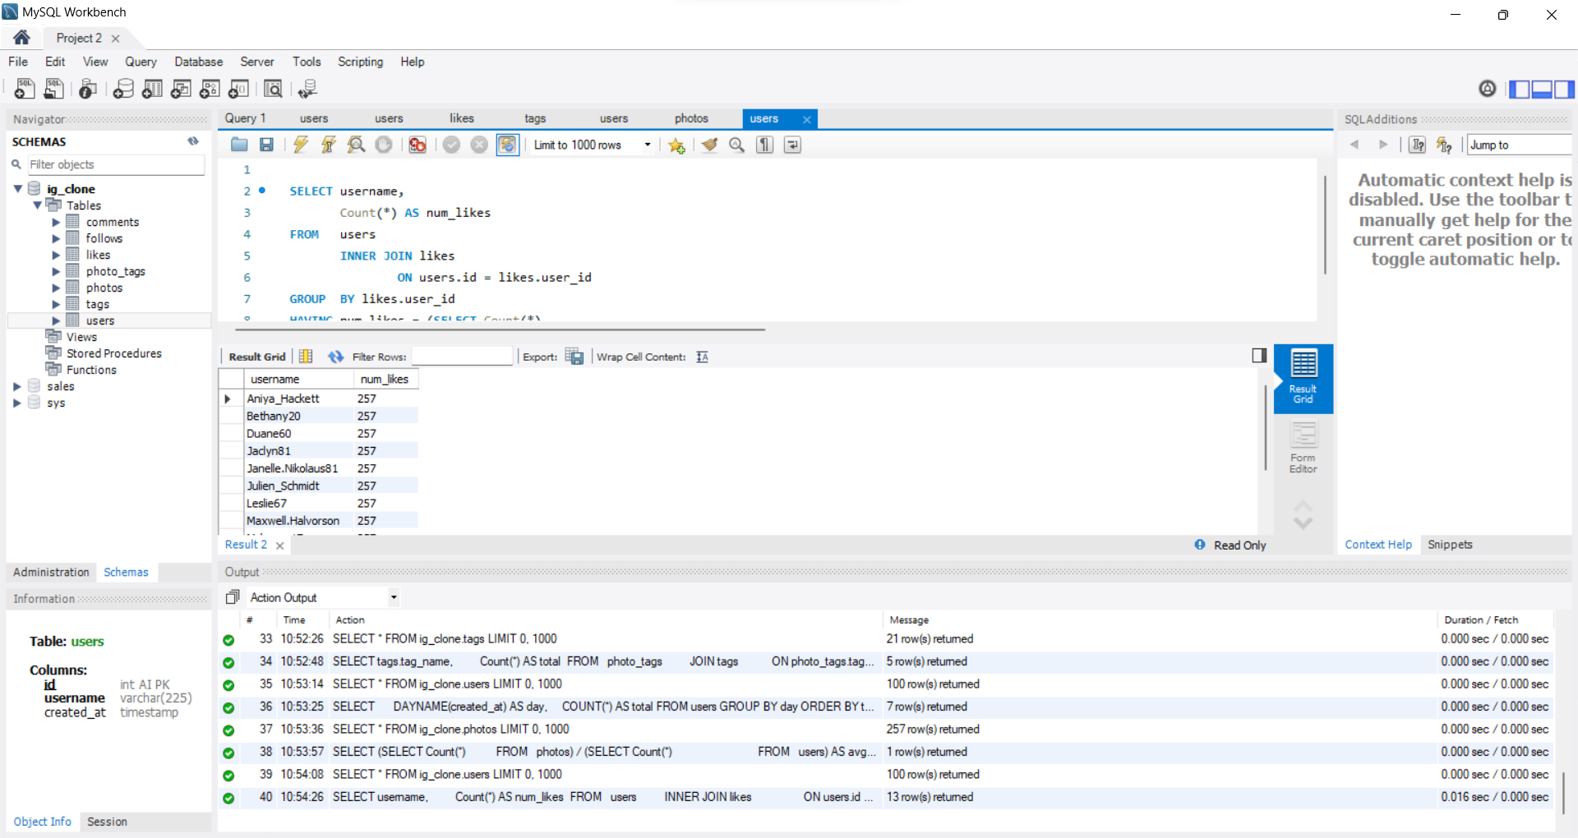
Bots & Fake Accounts

Slide 13
Insights
5 oldest users
From users table we can see that the created at column is showing date and year so I used ORDER BY(cause its default is in ascending order)and LIMIT .
Users who never posted
LEFT JOIN users and photos table
WHERE photos.id IS NULL (it will show users who never posted)
Winner
COUNT function for total(likes), INNER JOIN on likes & photos table & users and photos table, GROUP BY and ORDER BY DESC(for maximum likes) and LIMIT 1(winner must be one).
5 hashtags
JOIN tags and photos tags table, GROUP BY, ORDER BY and LIMIT 5.
AD Campaign
DAYNAME, COUNT, GROUP BY, ORDER BY
LIMIT 7( for whole week and to check which day most users register)

Slide 14
Result
Project
Investor Metrics
Marketing
Downloaded MySQL workbench successfully.
Took notes from the course content and tried to figure out the tasks given.
Wrote queries accordingly and took the screenshots.
Two tasks were given – average of total number of photos/users and bots and fake accounts
Used SQL keywords, wrote queries for particular task and got the desired output.
Completed all the 5 tasks given.
Gained knowledge of SQL functions and joins.
Learnt about COUNT(aggregate function) GROUP BY clause use aggregate functions.

Slide 15
The way to get started is to quit talking and begin doing.
Thank You !

